Slide 1

Vel Tech Rangarajan Dr. Sagunthala R&D Institute of Science and Technology
School of Computing
Department of Information Technology
10211IT224 / FULL STACK APPLICATION DEVELOPMENT (JAVA)
PROJECT REVIEW : MILESTONE PROJECT – 1
Date:25-03-2026
End-to-End Event Lifecycle & Ticketing Platform
SDG: SDG No – SDG Title(Example: SDG 4 – Quality Education)
Presented By:
STUDENT NAME – v.v.s siva kumar
VTU –26047
Reg.No:23UEIT0058
Courses Handling Faculty:
Dr. Visumathi J/ Professor/ IT

Slide 2
INTRODUCTION
Event management has become an essential part of modern digital platforms, especially for booking and organizing events efficiently. Many users still face difficulties in discovering events, booking tickets, and managing bookings manually.
The End-to-End Event Lifecycle & Ticketing Platform (EventHub) is a web-based application designed to simplify event discovery, booking, and management. It provides a seamless experience from event creation to ticket booking and tracking.
The platform ensures:
Easy browsing of events
Quick ticket booking
Organized event lifecycle management
Improved user experience
1
2
3
4
5
6
7
8
9

Slide 3
PROBLEM STATEMENT
In many cases, event management and ticket booking are handled manually or through disconnected systems.
This leads to difficulties in event discovery, complex booking procedures, and lack of proper tracking mechanisms. Users may face confusion while booking tickets, and administrators may struggle to manage multiple events simultaneously.
Additionally, the absence of real-time updates can result in inaccurate information and poor user satisfaction. Therefore, there is a need for a well-structured and automated system that can handle event lifecycle and ticketing operations efficiently.
These issues highlight the need for a modern, automated, and user-friendly event management system that can handle all operations efficiently.
1
2
3
4
5
6
7
8
9

Slide 4
OBJECTIVE(S)
To build a complete event lifecycle management system
To provide a simple and interactive user interface
To allow users to browse and book tickets easily
To enable admins to create and manage events
To track bookings and event statistics in real-time
To reduce manual errors and improve efficiency
1
2
3
4
5
6
7
8
9

Slide 5
PROPOSED SYSTEM
The proposed system is a web-based Event Lifecycle & Ticketing Platform.
User-friendly homepage (index.html)
Event browsing section
Ticket booking system (Cart & Booking)
Admin panel to create events
Real-time event updates
Dashboard statistics (events, tickets, revenue)
1
2
3
4
5
6
7
8
9

Slide 6
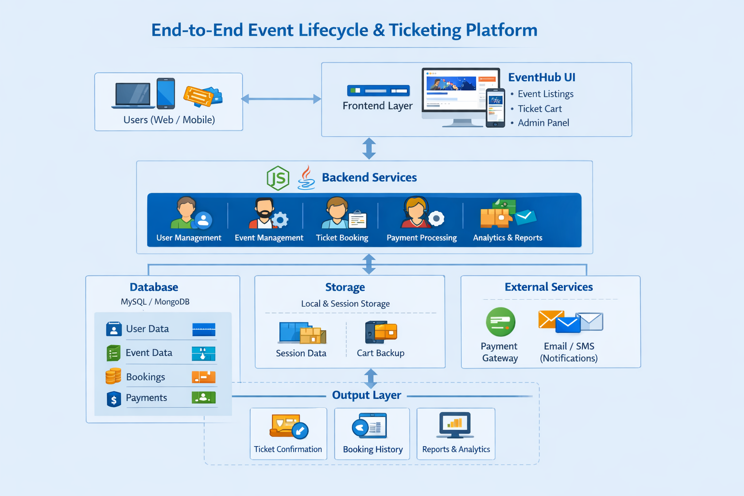
PROPOSED SYSTEM ARCHITECTURE
1
2
3
4
5
6
7
8
9

Slide 7
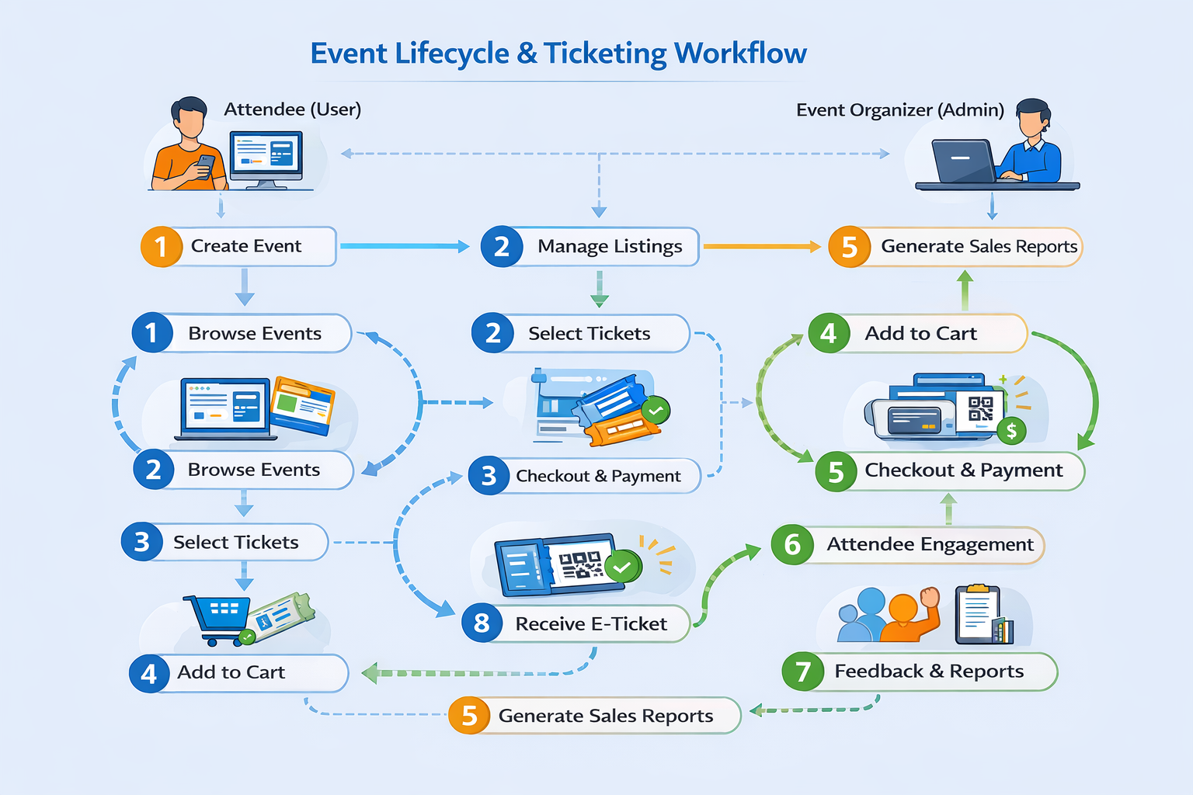
WORKFLOW
1
2
3
4
5
6
7
8
9

Slide 8
TECHNOLOGIES USED
1
Frontend: HTML5, CSS3, JavaScript
Backend (Optional/Extension): Node.js / PHP
Storage: LocalStorage / Database
Tools: VS Code
Platform: Web Browser
2
3
4
5
6
7
8
9

Slide 9
MODULE DESCRIPTION
1
User Interface
Homepage with navigation bar
Hero section and featured events
Event Management
Display all events
Show event details
Booking System
Add to cart
Manage bookings
Admin Panel
Create new events
Manage event details
Dashboard & Stats
Total events
Tickets sold
Revenue tracking
2
3
4
5
6
7
8
9

Slide 10
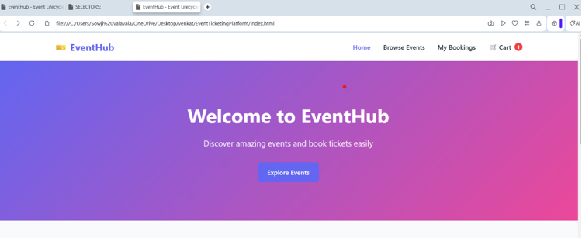
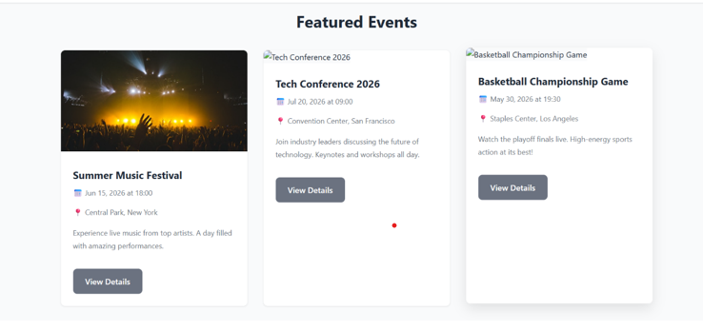
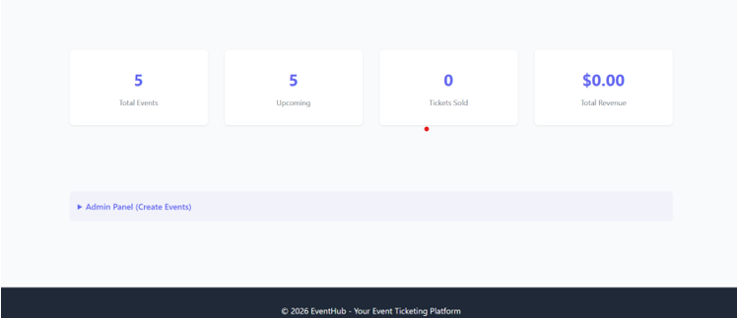
IMPLEMENTATION SCREENSHOTS
Home Page:
Displays EventHub title
Navigation bar (Home, Events, Cart, Bookings)
Hero section with CTA button
Displays the main homepage of the system with the
platform name EventHub and navigation menu at the top
It includes options like Home, Browse Events, My Bookings,
and Cart. Acts as the entry point for users to explore
the platform easily.
1
2
3
4
5
6
7
8
9

Slide 11
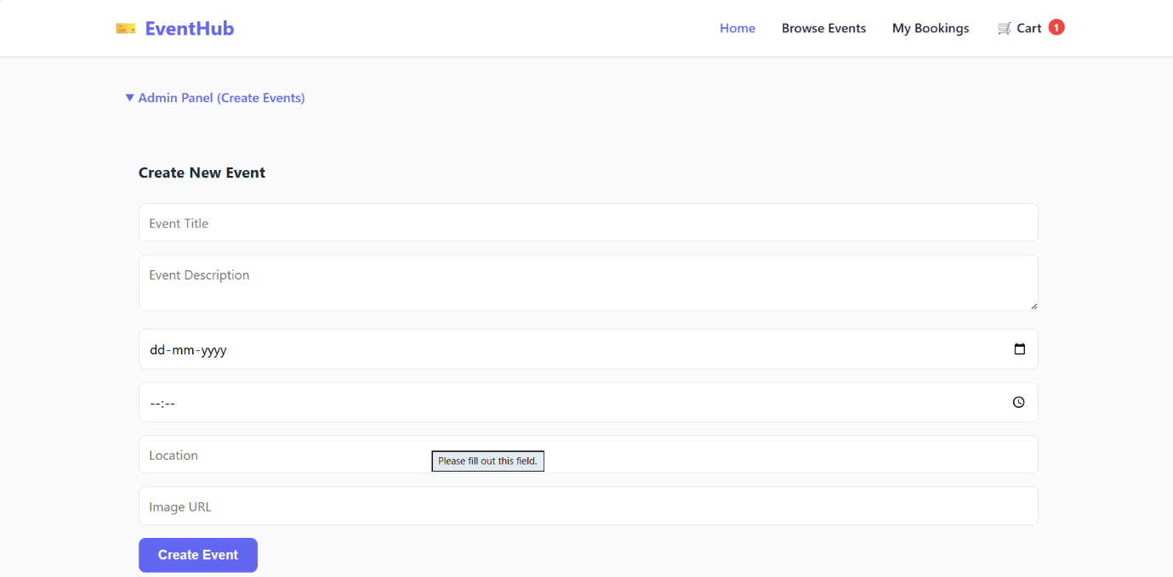
IMPLEMENTATION SCREENSHOTS
Events Page
Shows list of available events
Event details like date, location
Shows the event listing page where all available events
are displayed with details such as event name, date, time,
and Helps users to view and select events for booking.
Displays the cart page where selected tickets are shown.
Allows users to review their bookings and proceed with confirm-
ation.Improves accuracy in ticket selection.
1
2
3
4
5
6
7
8(A)
9

Slide 12
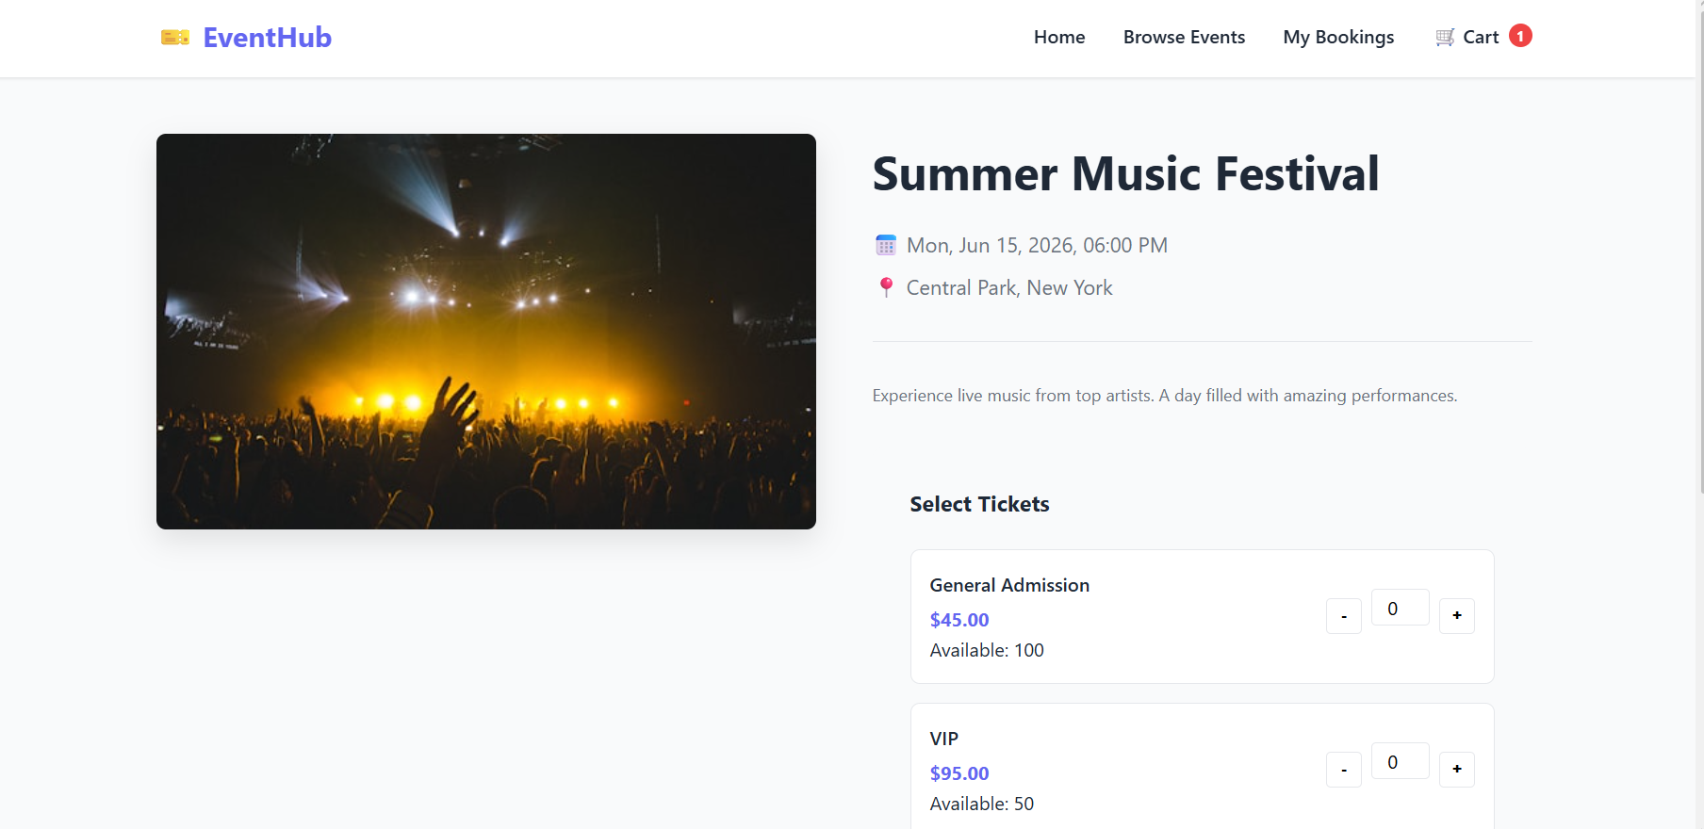
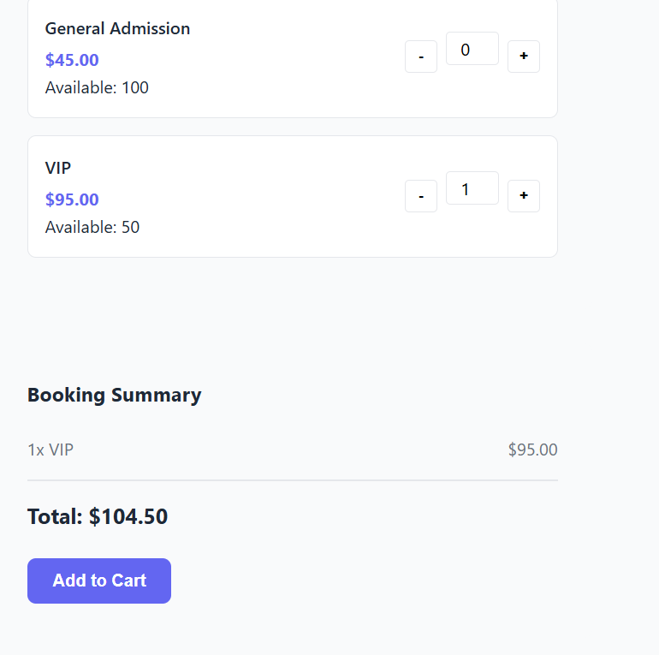
IMPLEMENTATION SCREENSHOTS
Cart Page
Displays selected tickets
Booking confirmation
Persistent cart storage
The implementation of the system includes various functional components such as the home page, event listing page, cart page, and admin panel.
1
2
3
4
5
6
7
8(B)
9

Slide 13
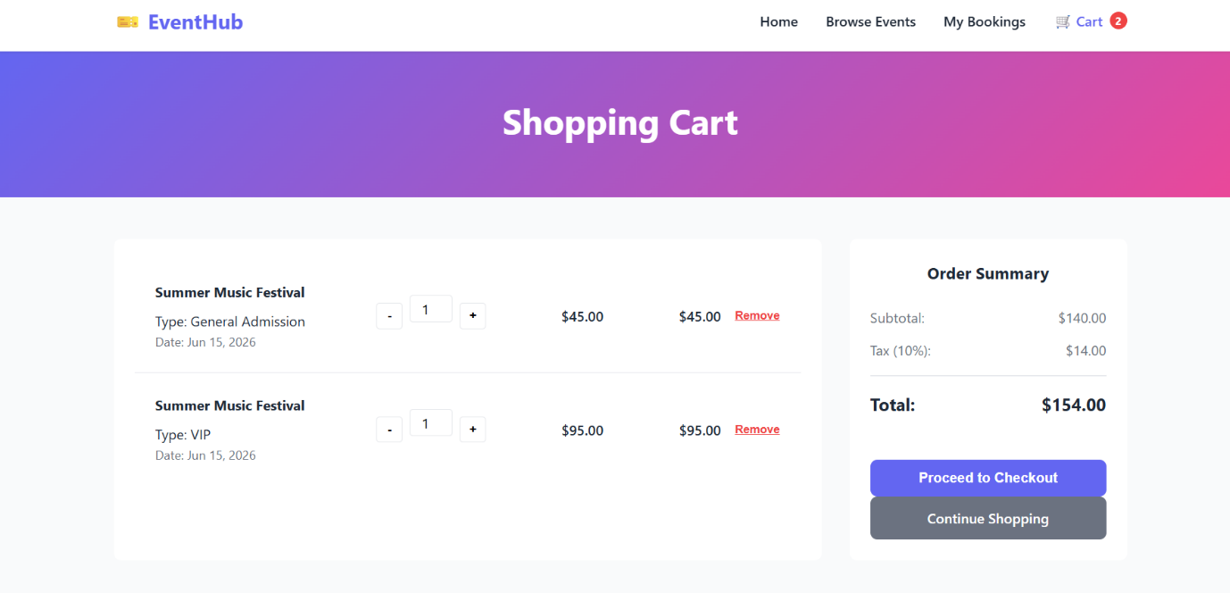
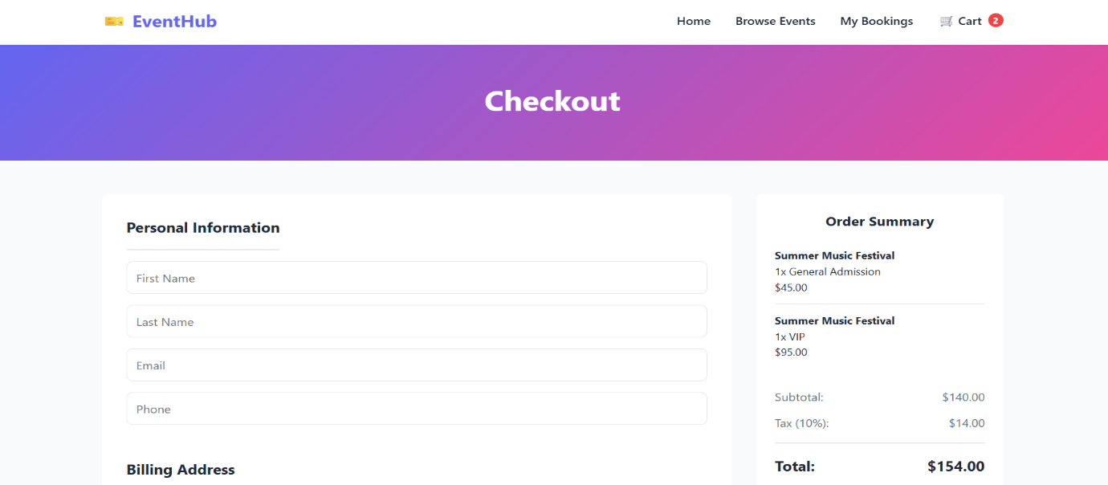
IMPLEMENTATION SCREENSHOTS
Admin Panel
Create new event form
Add event details (title, date, location)
The admin panel enables event organizers to create and manage events. These components work together to provide a seamless and efficient user experience.
1
2
3
4
5
6
7
8(C)
9

Slide 14
ADVANTAGES & LIMITATIONS
1
ADVANTAGES
Easy event booking
Persistent cart (no data loss)
User-friendly interface
Responsive design
Real-time updates
Efficient event management
LIMITATIONS
Depends on browser storage
Depends on browser storage
No offline functionality
Payment integration complexity
2
3
4
5
6
7
8
9

Slide 15
Thank you

